Slide 1


Slide 2

ML Project – Movie Ratings Prediction
Presented by – Mohit Tarade Presented to – Sameer Sir(IT vedant)

Slide 3
To predict movie ratings, we can conduct an ablation study of various visual and textual features and evaluate their performance in the prediction accuracy. As from the data set I have identified that the target data(Ratings) is of continuous nature so in the project I have used Linear Regression, decision tree, random forest and SVR as input algorithms. This will help to get the best accuracy method to get the accurate ratings prediction of upcoming movies. In this project, we aim to build a predictive model to estimate movie ratings based on a set of features. By using various models for this task, leveraging the scikit-learn library in Python.

Slide 4
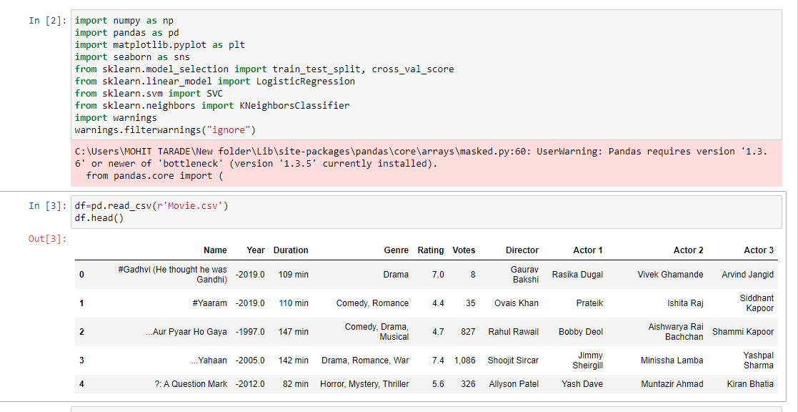
Predicting movie success is a complex task that involves analyzing data from various sources like box office collections, social media, critic reviews, and audience ratings. So initially I have imported all the required Libraries and imported the file having movies data as in the ss below:
Viewed data using .head() which shows only top 5 records.

Slide 5
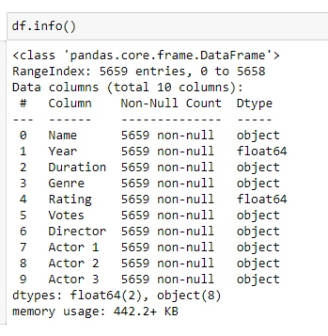
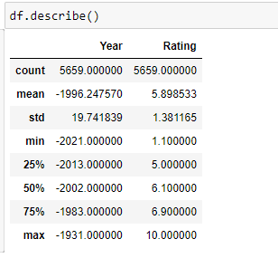
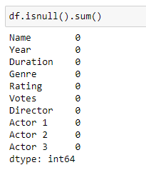
EDA – Now will proceed with exploratory analysis part where I have checked the data structure using .info() which shows there 5659 rows and 10 columns available in our dataset.also we can see the type of column, integer or a string(object). I used .isnull().sum() to check if any empty places available in the data, as we can see there are no empty cell available so we can move to next part. To check the central tendency, SD, min, max of numerical values we used .describe().

Slide 6
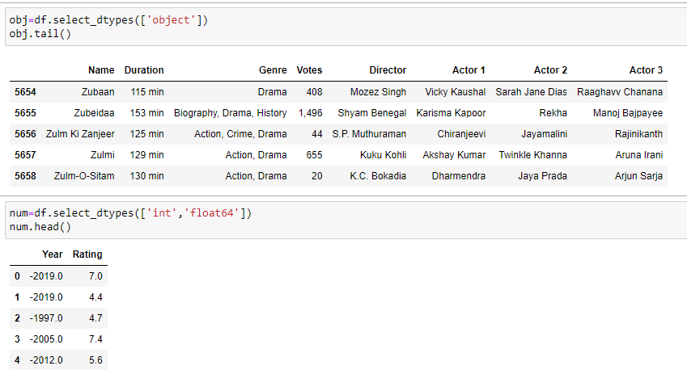
Now as we have identified that there are few string/object data types available so will first need to convert it into integer type. For this I have used label encoder which converts object data types to integer. So I have classified the object data and int/float data separate.

Slide 7
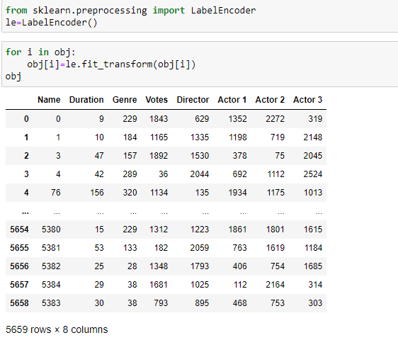
Using Label Encoding method converted string data type to integer.

Slide 8
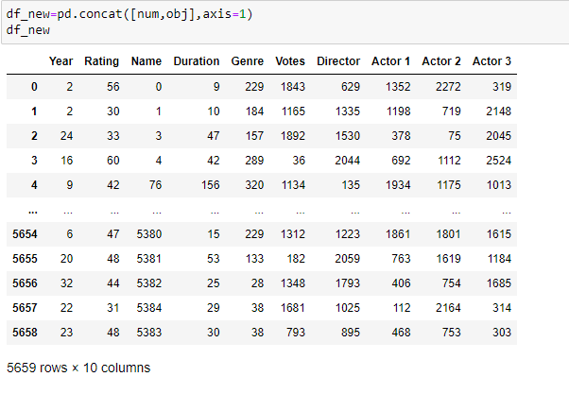
As encoding is done so will connect both tables using .concat() with axis 1 i.e. column joining. Now as this is new table formed so we have given name as df_new.

Slide 9
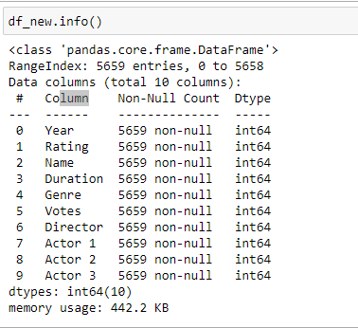
Now we can check if the data type is updated or not using .info().

Slide 10
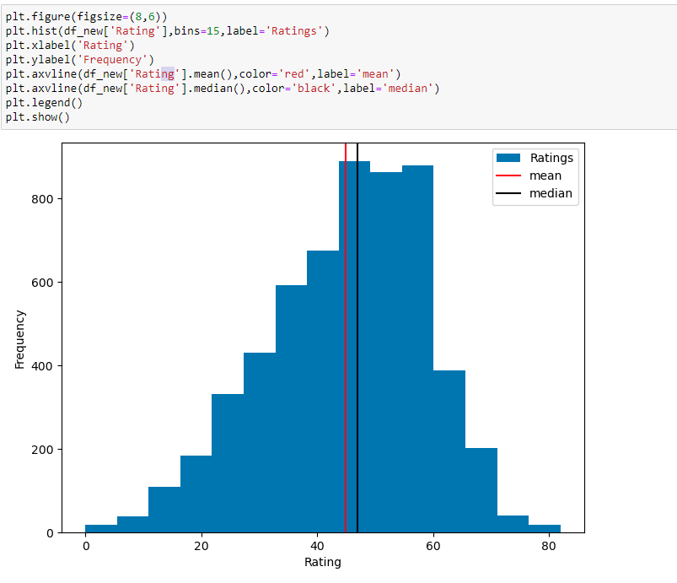
Now using graphs we will check Visual representation of the data. Here using Histogram will check the spread of the ratings data along with x & y axis by pointing the mean and median of data using .axvline().

Slide 11
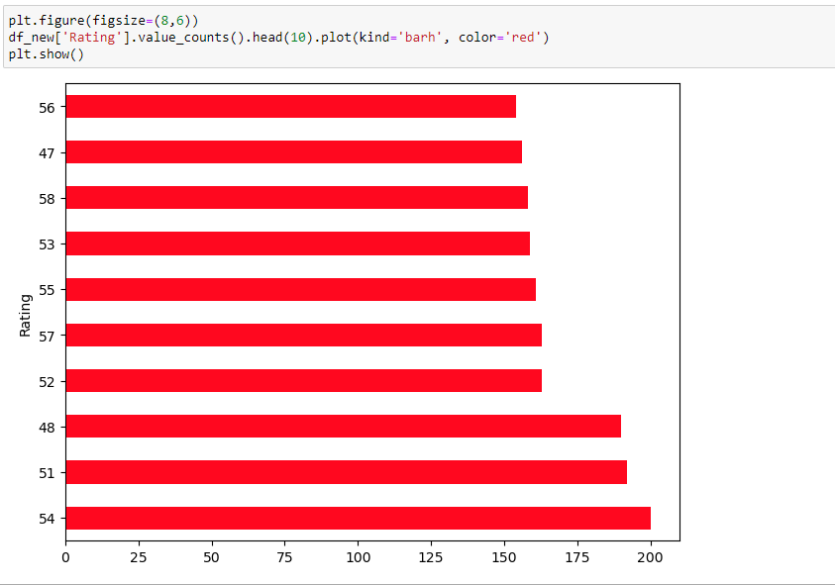
Top 10 rating counts shown using horizontal bar graph.

Slide 12
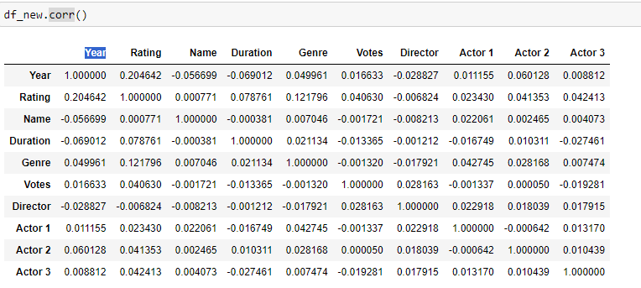
Now before proceeding its important to find out the correlation between columns so we can get to know the not required columns which we can ignore in further analysis. Using .corr().

Slide 13
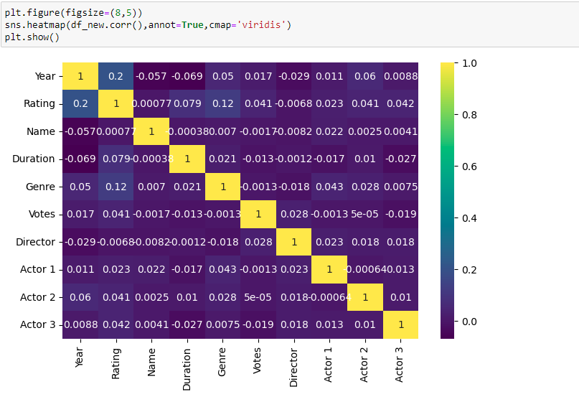
Using Heatmap a visual tool to see the correlation within the data.

Slide 14
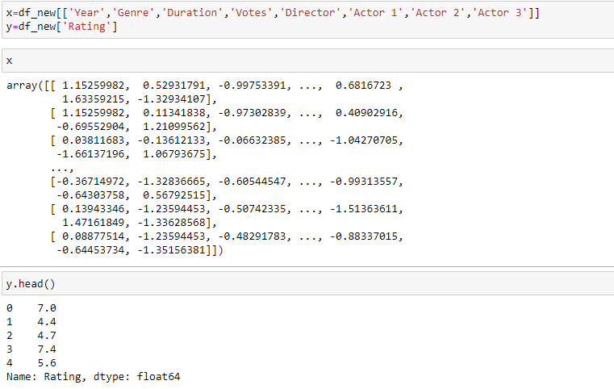
As per correlation we can see that name do not contribute much in the analysis, hence will not include it in our model building process. And Now will split X & Y.

Slide 15
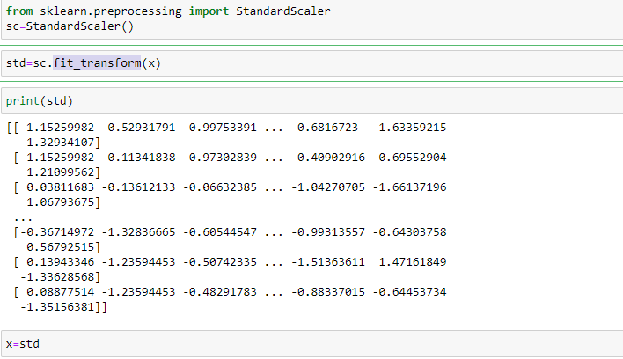
Scaling down the X using Standard Scalar.

Slide 16
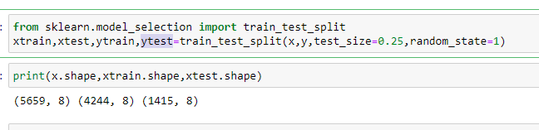
Splitting Data and Model Building
We will split the data into xtrain and ytrain using train_test_split into 75-25 criteria with random state 1.

Slide 17
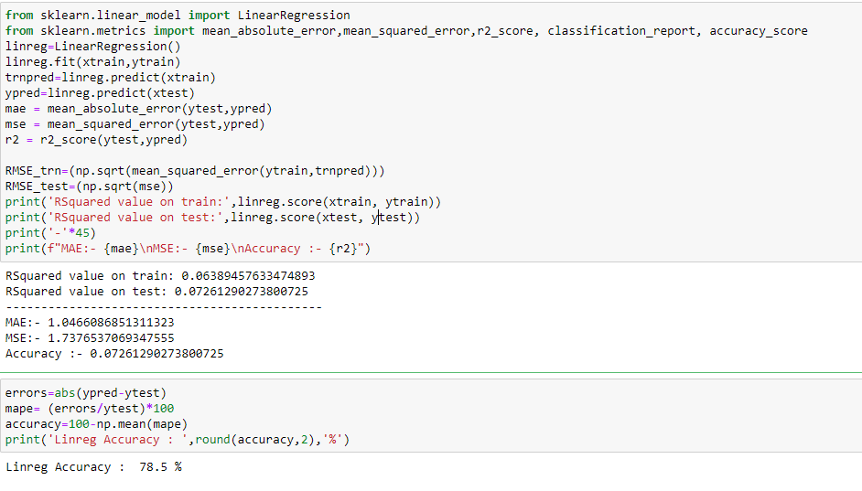
Linear Regression
The code provides a comprehensive evaluation of the linear regression model's performance on both the training and test datasets using various metrics. Using MAPE as a measure of accuracy for a linear regression model, and the accuracy is then presented as a percentage. The lower the MAPE, the higher the accuracy of the model.

Slide 18
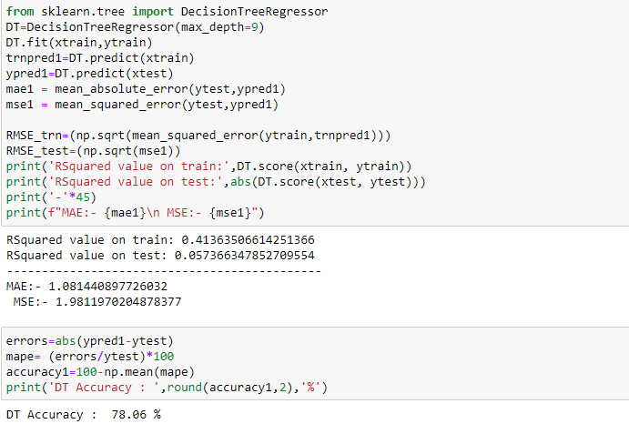
Decision Tree

Slide 19
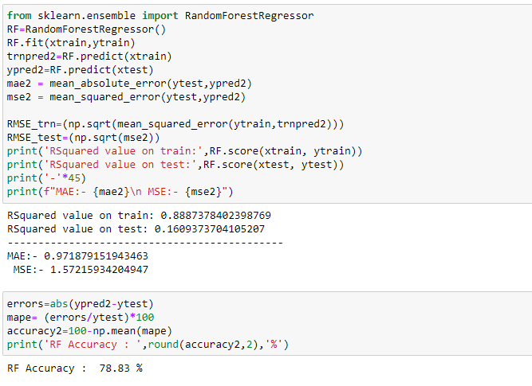
Random Forest

Slide 20
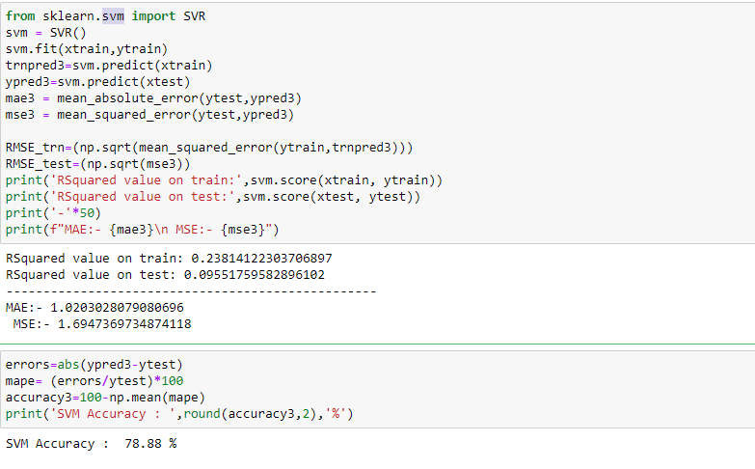
Support Vector Machine

Slide 21
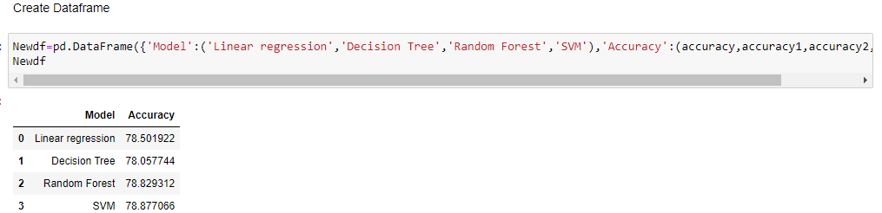
Created a Dataframe to get the accuracy of all model to compare the better option to build a model to get best ratings prediction. As per table we can see that the SVM is the best model to implement in getting ratings prediction.

Slide 22
Conclusion :
In conclusion, our SVR model shows promise in predicting movie ratings based on selected features. The comprehensive evaluation metrics provide a clear understanding of the model's strengths and weaknesses. As we continue to refine and expand our approach, this project sets the foundation for further advancements in movie ratings prediction.

